Slide 1

RESUME CLASSIFICATION
Project Members:
1.) Mr. Gaurang manjrekar
2.) Mr. samad khatri
3.) Mr. harish kate
5.) Mr. swapnil revekar
6.) Mr. sidhodhan ahire
7.) Mr. shivprasad jadhav
4.)Bhumika patil

Slide 2
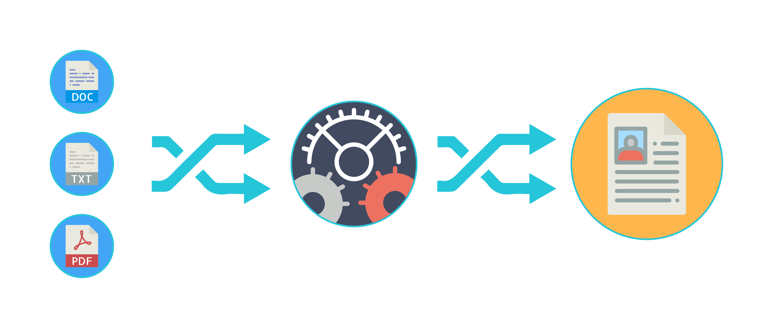
Business objective-
The document classification solution should significantly reduce the manual human effort in the HRM. It should achieve a higher level of accuracy and automation with minimal human intervention
Abstract:
A resume is a brief summary of your skills and experience. Companies recruiters and HR teams have a tough time scanning thousands of qualified resumes. Spending too many labor hours segregating candidates resume's manually is a waste of a company's time, money, and productivity. Recruiters, therefore, use resume classification in order to streamline the resume and applicant screening process. NLP technology allows recruiters to electronically gather, store, and organize large quantities of resumes. Once acquired, the resume data can be easily searched through and analyzed.
Resumes are an ideal example of unstructured data. Since there is no widely accepted resume layout, each resume may have its own style of formatting, different text blocks and different category titles. Building a resume classification and gathering text from it is no easy task as there are so many kinds of layouts of resumes that you could imagine

Slide 3



Data Preprocessing
Exploratory data analysis (EDA)
Project Architecture / Project Flow
Model Deployment
Model Building/ Evaluation
Data Scrapping
Understanding Data

Slide 4
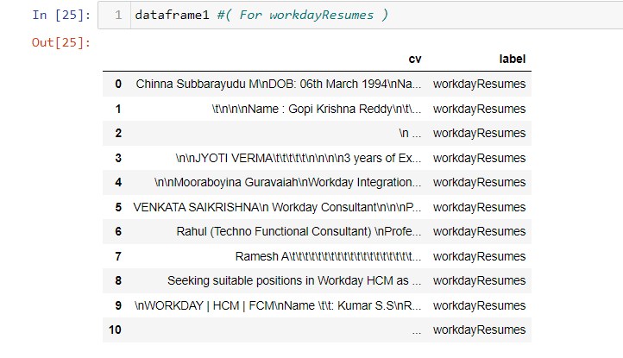
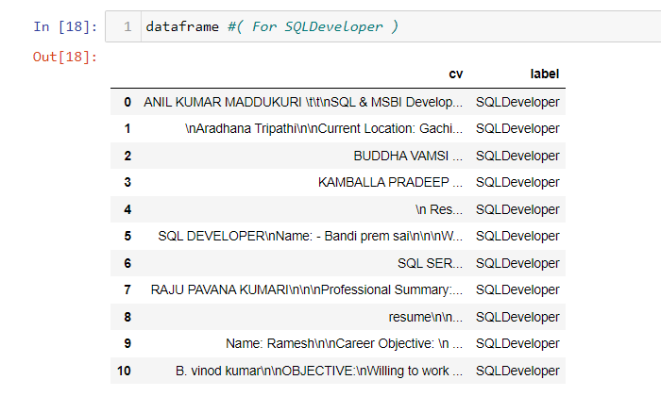
Data set details
We have categorized the resumes in each category and then we have used glob function to get their file paths and then we have scrapped the data from all categories and created their respective dataframe
Preview of Scrapped Data From Different Folders

Slide 5
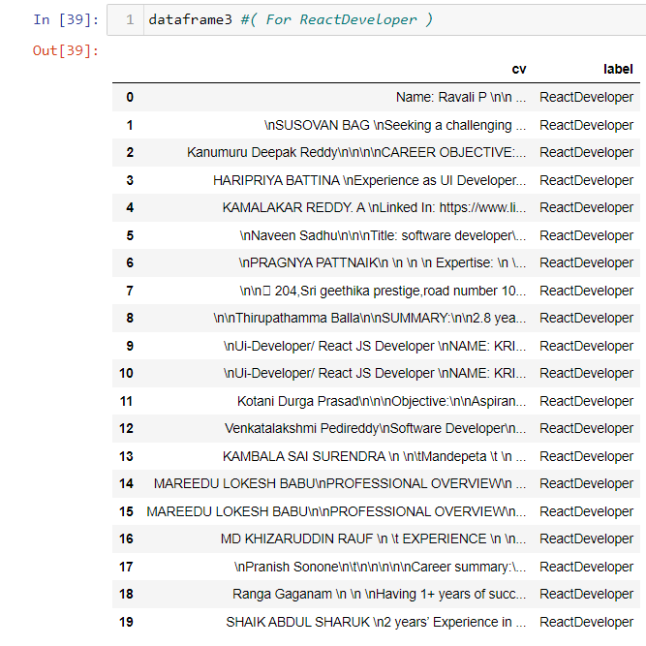
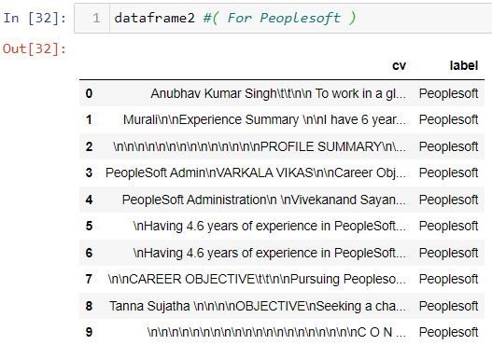
Data set details

Slide 6
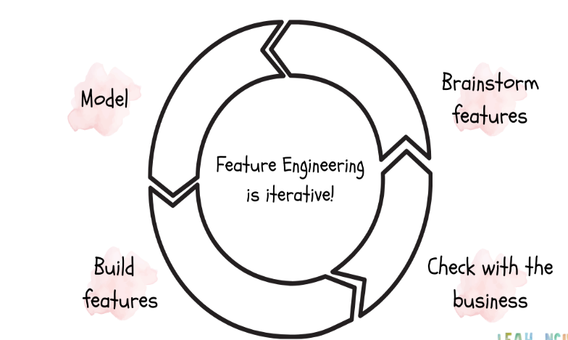

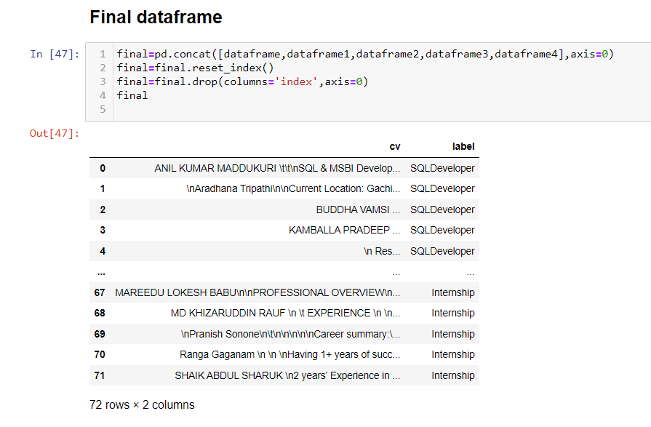
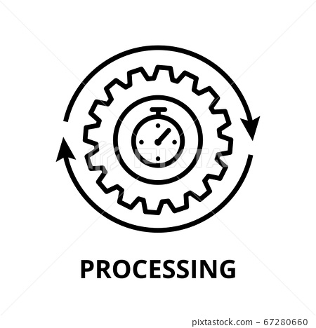
Feature Engineering
We Have Concatenated All The Data Frame To Make Our Final Dataframe

Slide 7
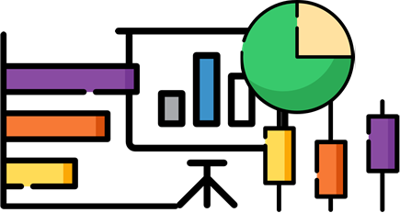


Exploratory Data Analysis (EDA)

Slide 8
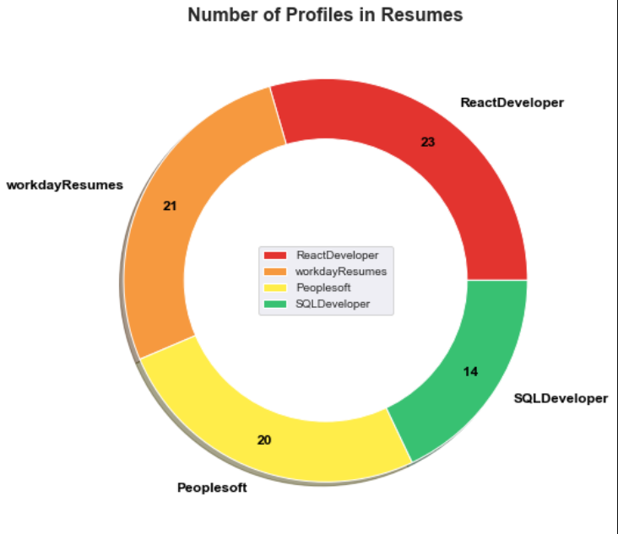
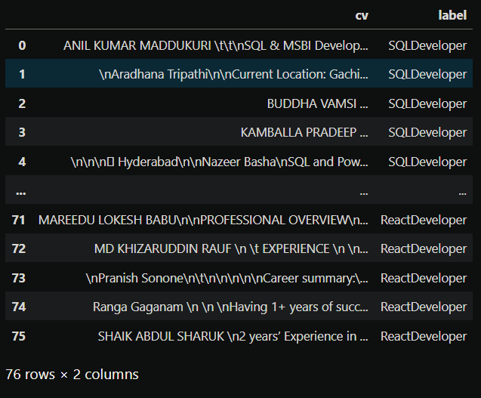
Exploratory Data Analysis :

Slide 9
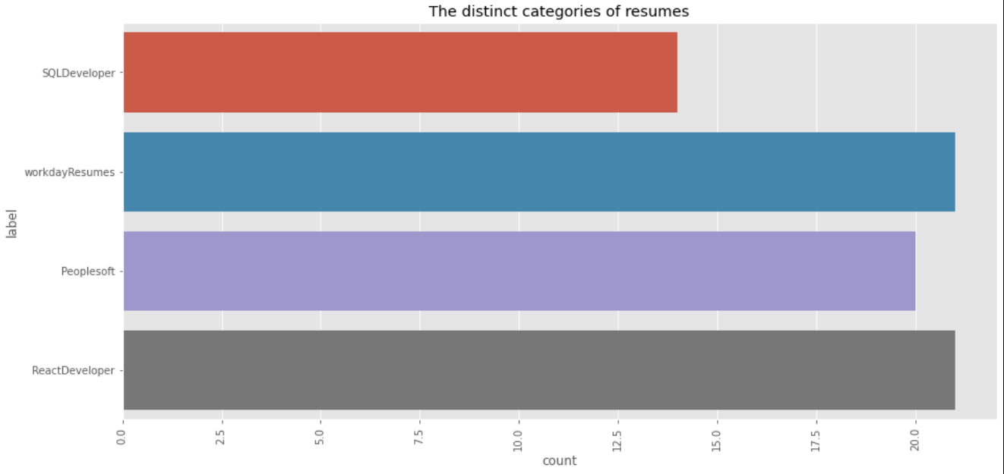
Exploratory Data Analysis :
Distinct Categories of Resume’s.

Slide 10
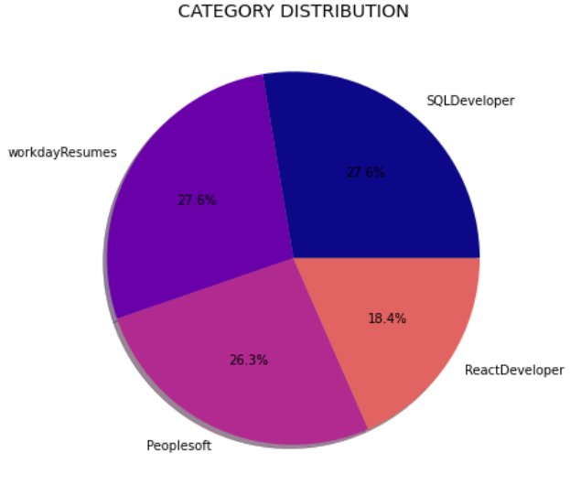
Exploratory Data Analysis :
Extracting Text from different Resume files and creating a data-frame with Column of Text from Resumes And labels for which each of it Applied for.

Slide 11
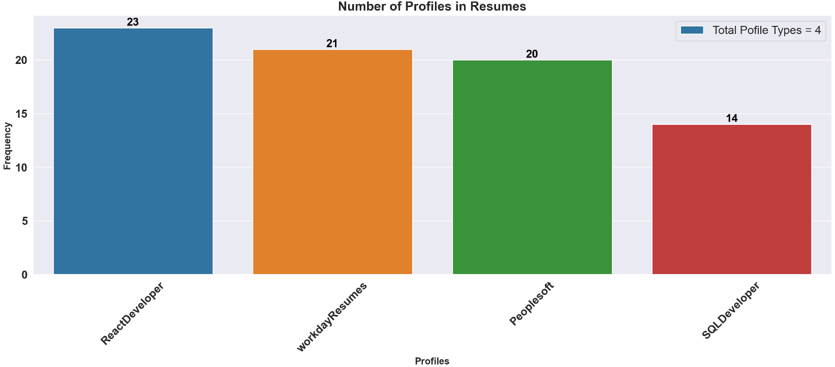
Exploratory Data Analysis Number of Classes in Data-Frame

Slide 12
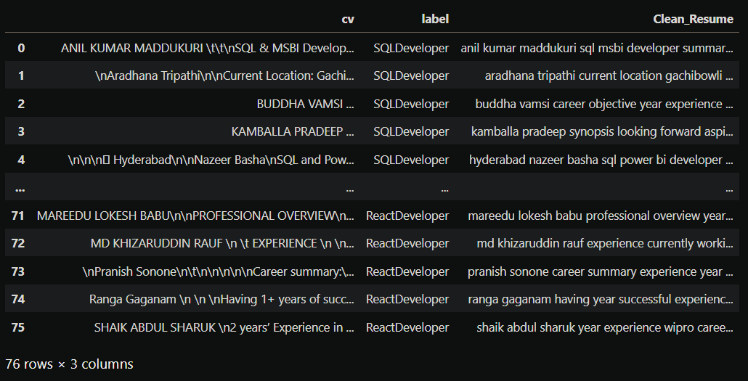
Text pre-processing :
Text pre-processing includes converting to lowercase, removing spaces, html links, emails, symbols, numbers, stop-words, tokenization and lemmatization.
Removing All Unwanted Character’s
Word Tokenization - Tokenization is essentially splitting a phrase, sentence, paragraph, or an entire text document into smaller units, such as individual words or terms. Each of these smaller units are called tokens.
Removing Stop-words - A stop word is a commonly used word (such as “the”, “a”, “an”, “in”) that a search engine has been programmed to ignore, both when indexing entries for searching and when retrieving them as the result of a search query.

Slide 13
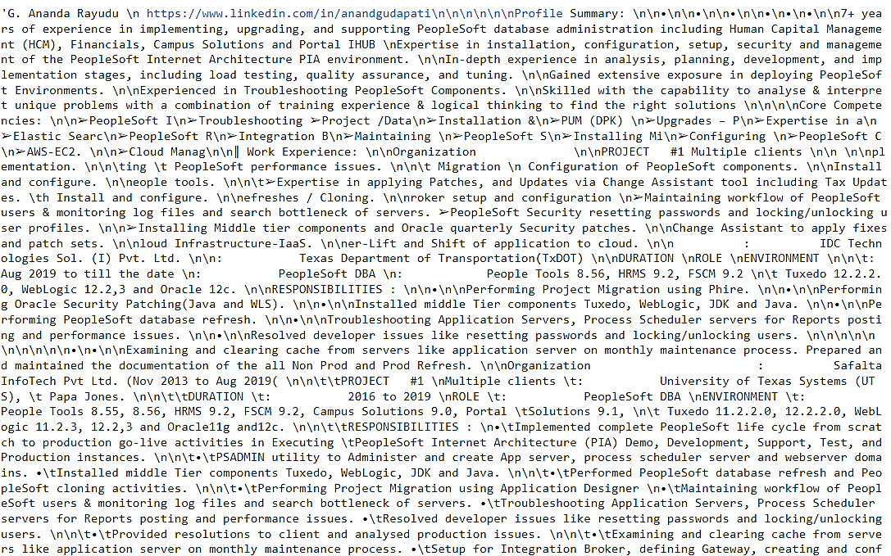
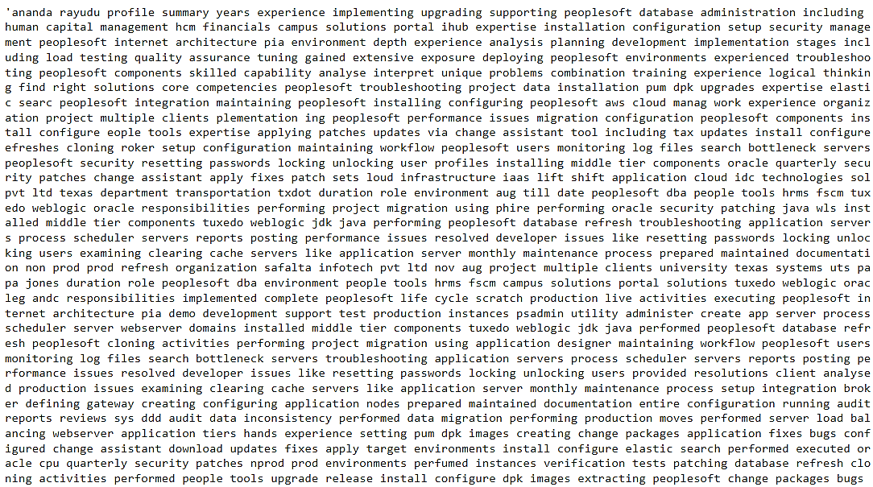
Text pre-processing :
Before Text pre-processing
After Text pre-processing

Slide 14
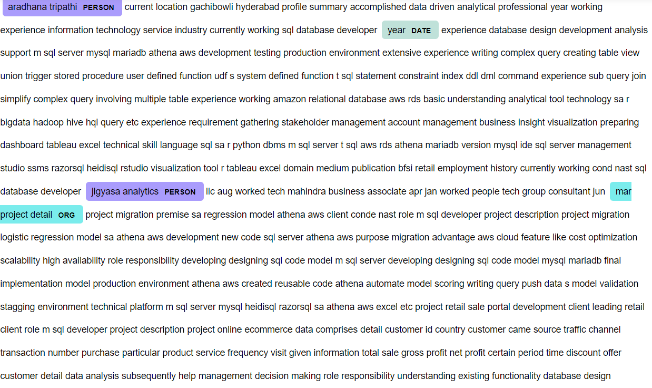
NER (Name Entity Recognition)
It involves the identification of key information in the text and classification into a set of predefined categories.
An entity is basically the thing that is consistently talked about or refer to in the text. NER is the form of NLP.

Slide 15
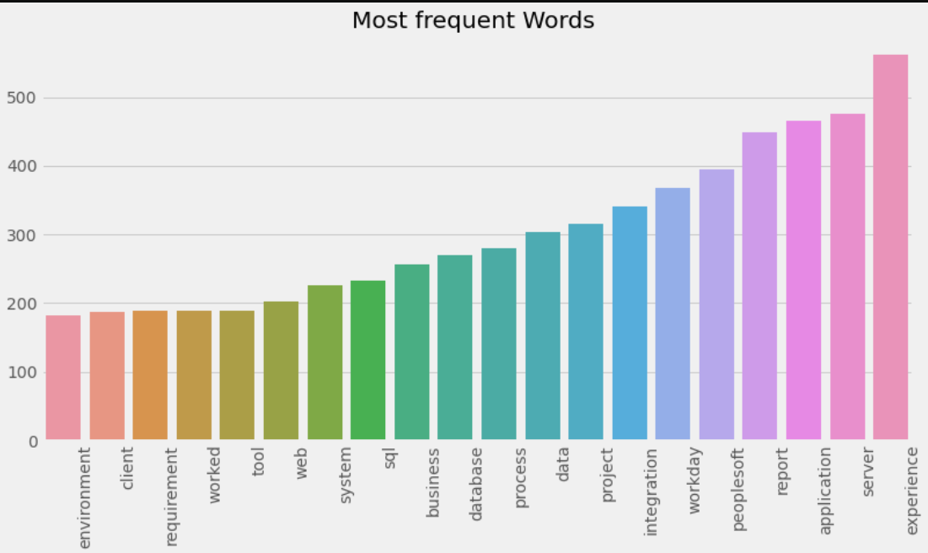
Exploratory Data Analysis :

Slide 16
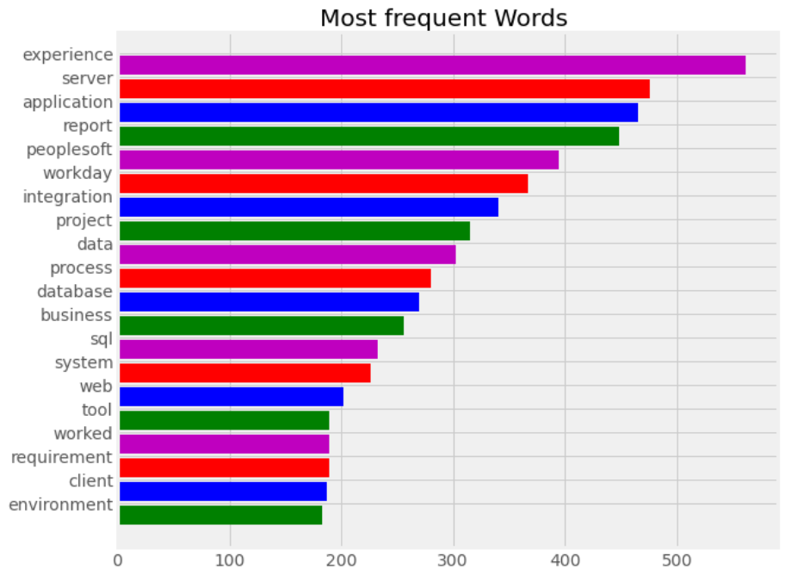
Exploratory Data Analysis :

Slide 17
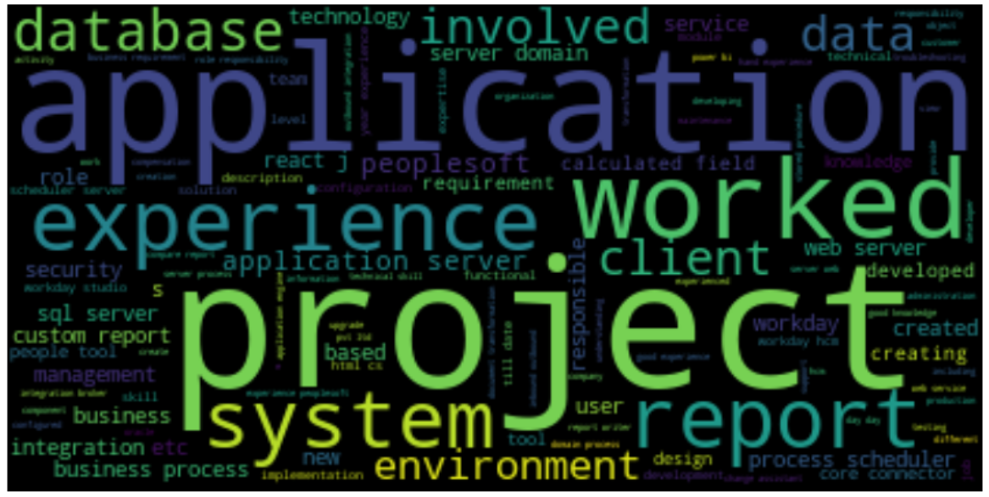
Word cloud:

Slide 18
FEATURE ENGINEERING
vectorization - The idea is to get some distinct features out of the text for the model to train on, by converting text to numerical vectors.
TF-IDF stands for term frequency-inverse document frequency , that can quantify the importance or relevance of string representations (words, phrases, lemmas, etc) in a document amongst a collection of documents (also known as a corpus).

Slide 19
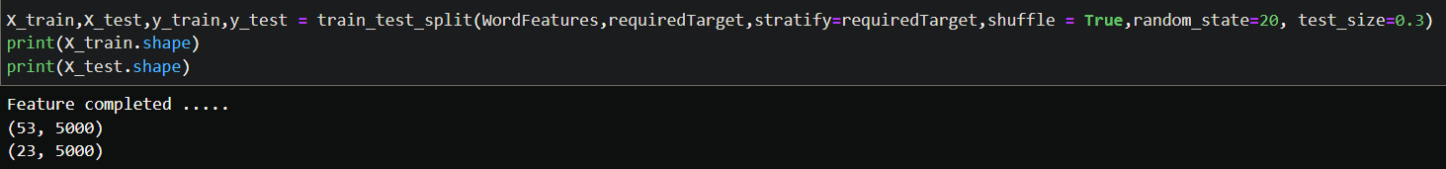
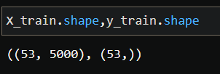
Train Test Split:
DATA SPLITTING – WE HAVE KEPT 70% FOR TRAIN SET AND 30% FOR TEST SET

Slide 20
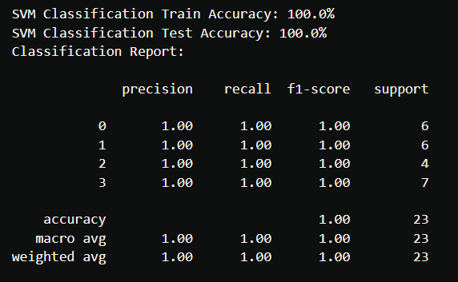
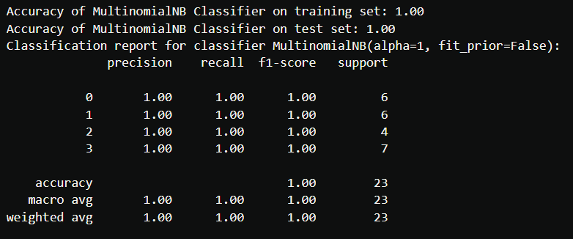
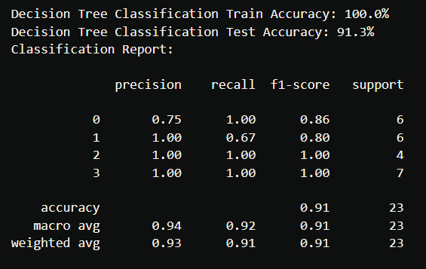
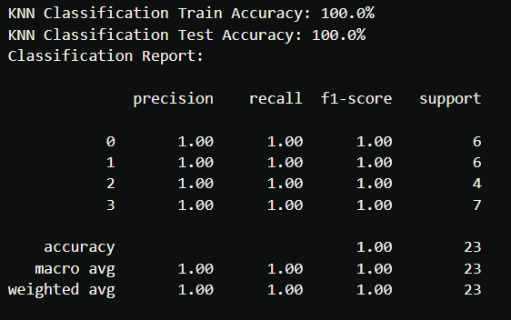
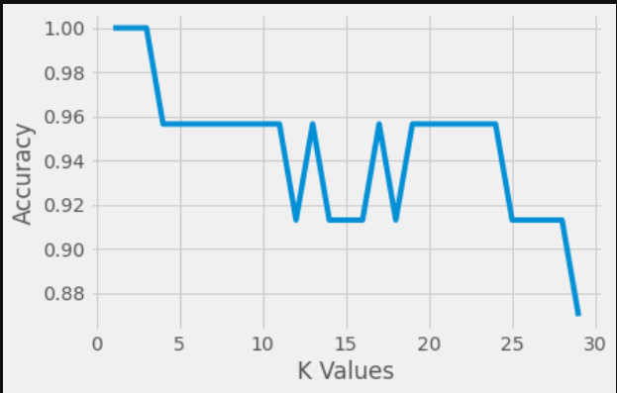
Model Building:
Support Vector Machine
Naïve Bayes Classifier
Decision Tree
Kneighbors Classifier
Accuracy vs K Values for KNN

Slide 21
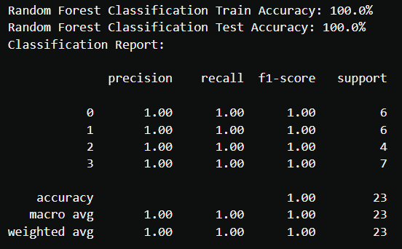
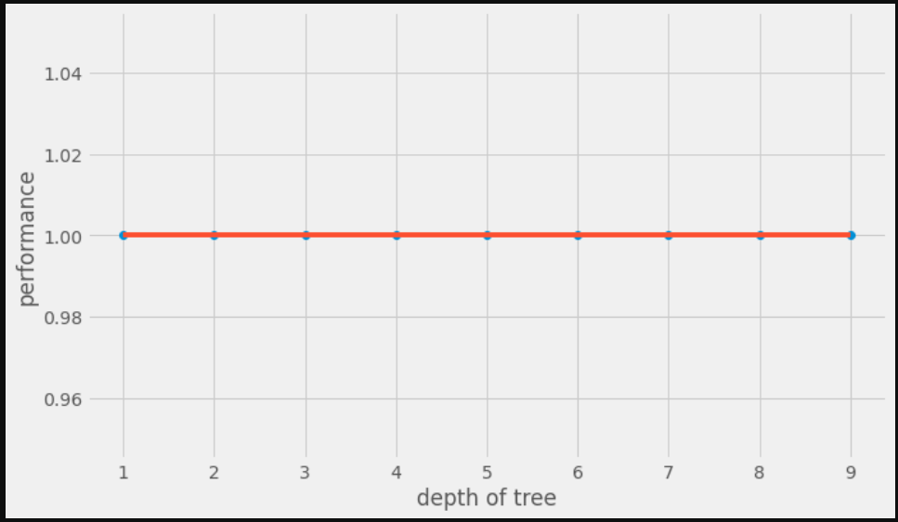
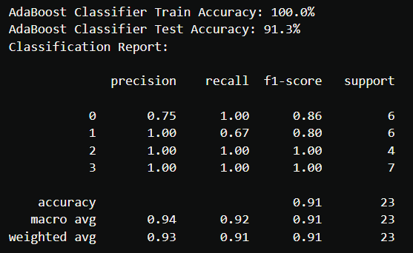
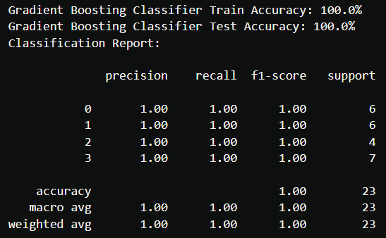
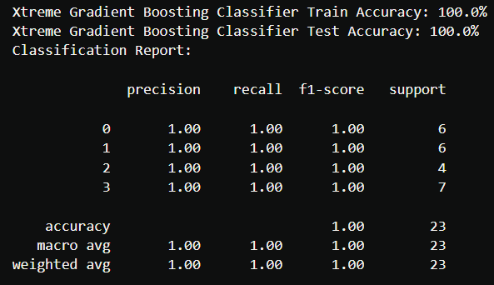
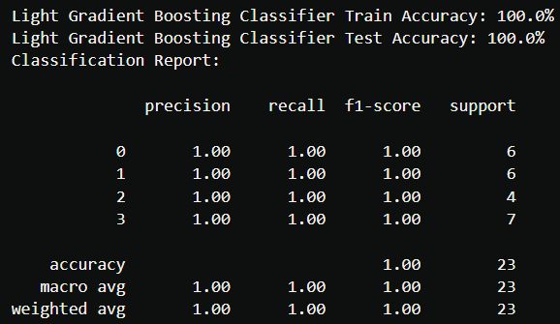
Model Building:
Random Forest
Train and Test Performance for RF
AdaBoost Classifier
Gradient Boosting Classifier
Xtreme Gradient Boosting Classifier
Light Gradient Boosting Classifier

Slide 22
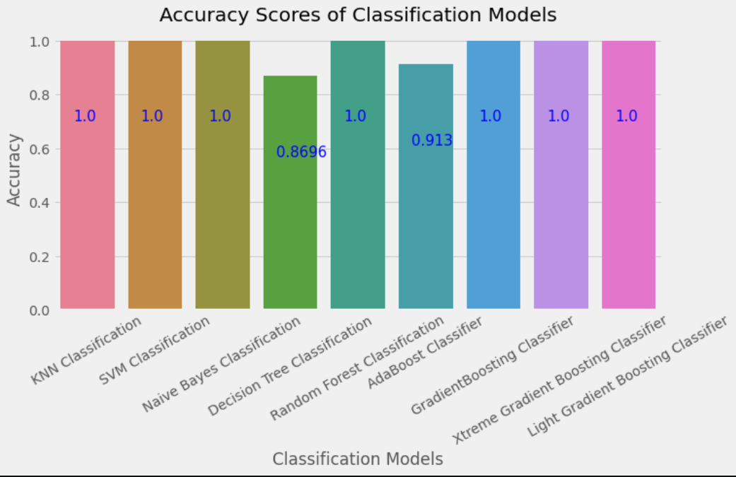
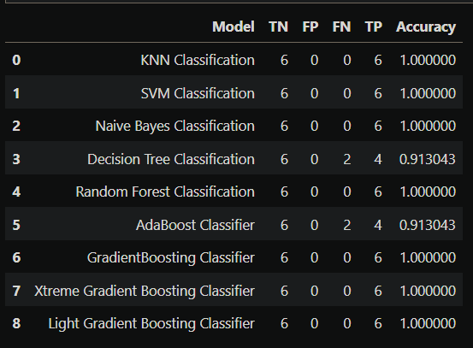
Model Building:
Test Accuracy Score for all Classification Models

Slide 23
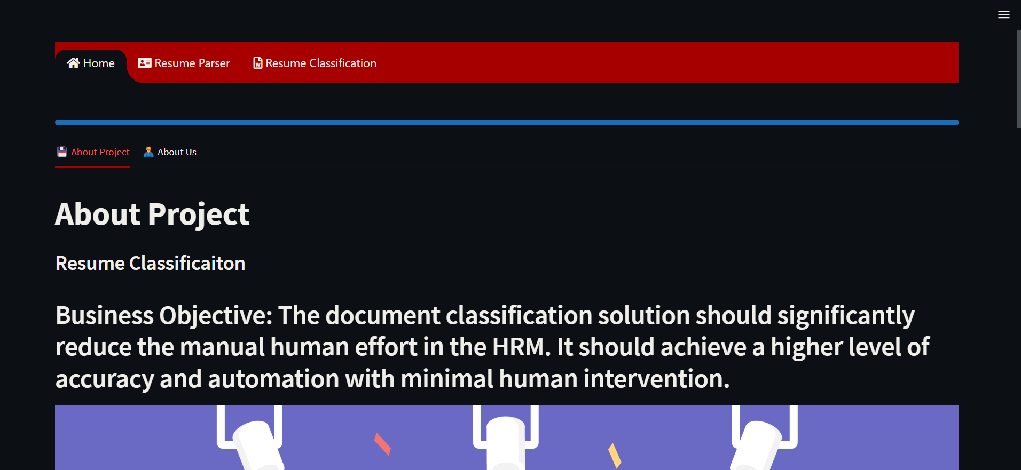
deployment:

Slide 24
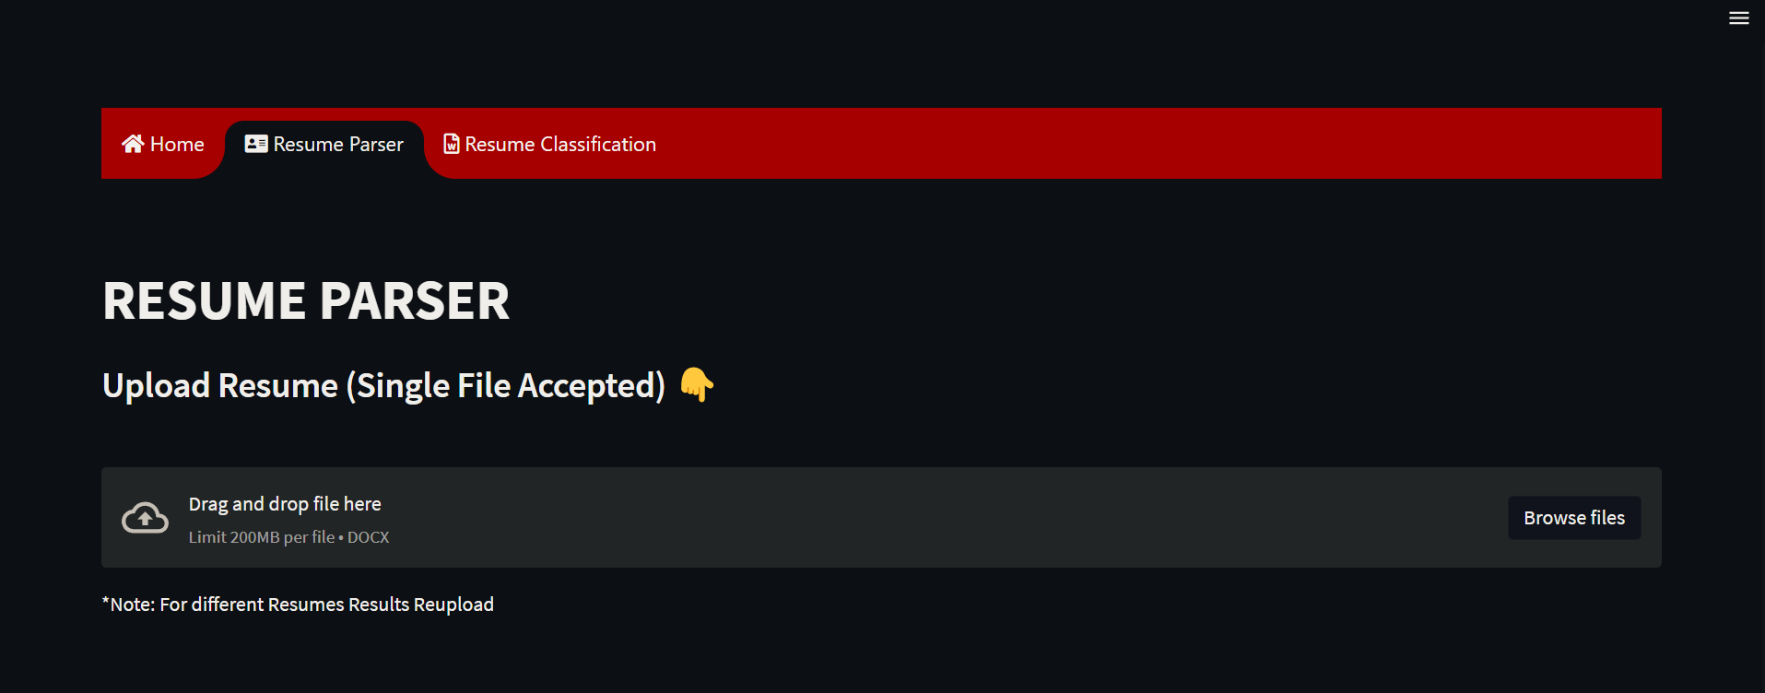
deployment:

Slide 25
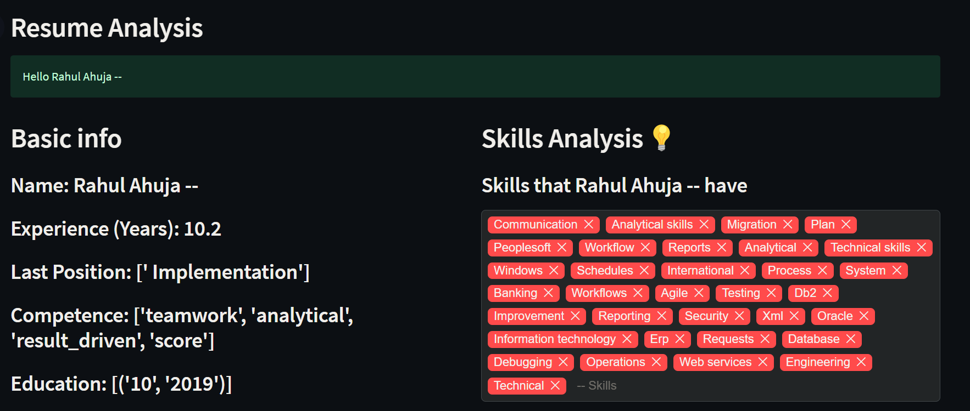
deployment:

Slide 26
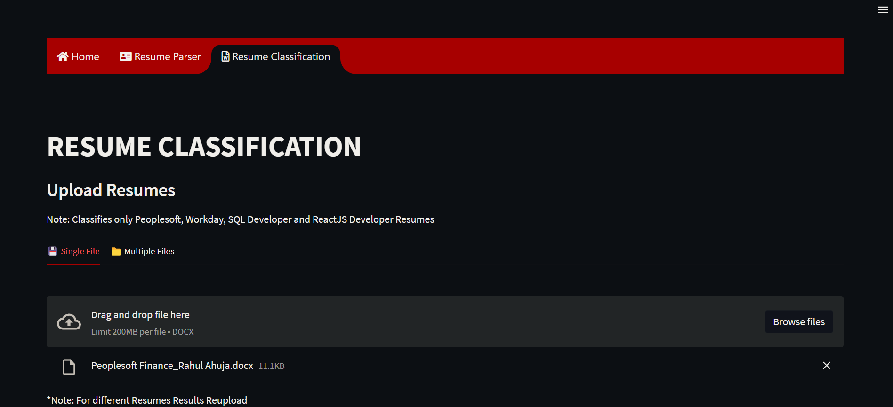
deployment:

Slide 27
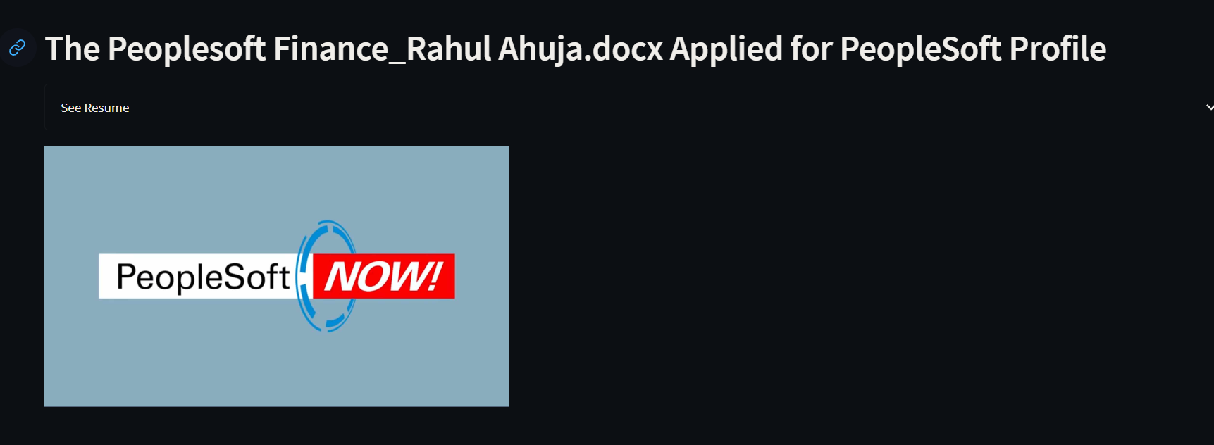
deployment:

Slide 28
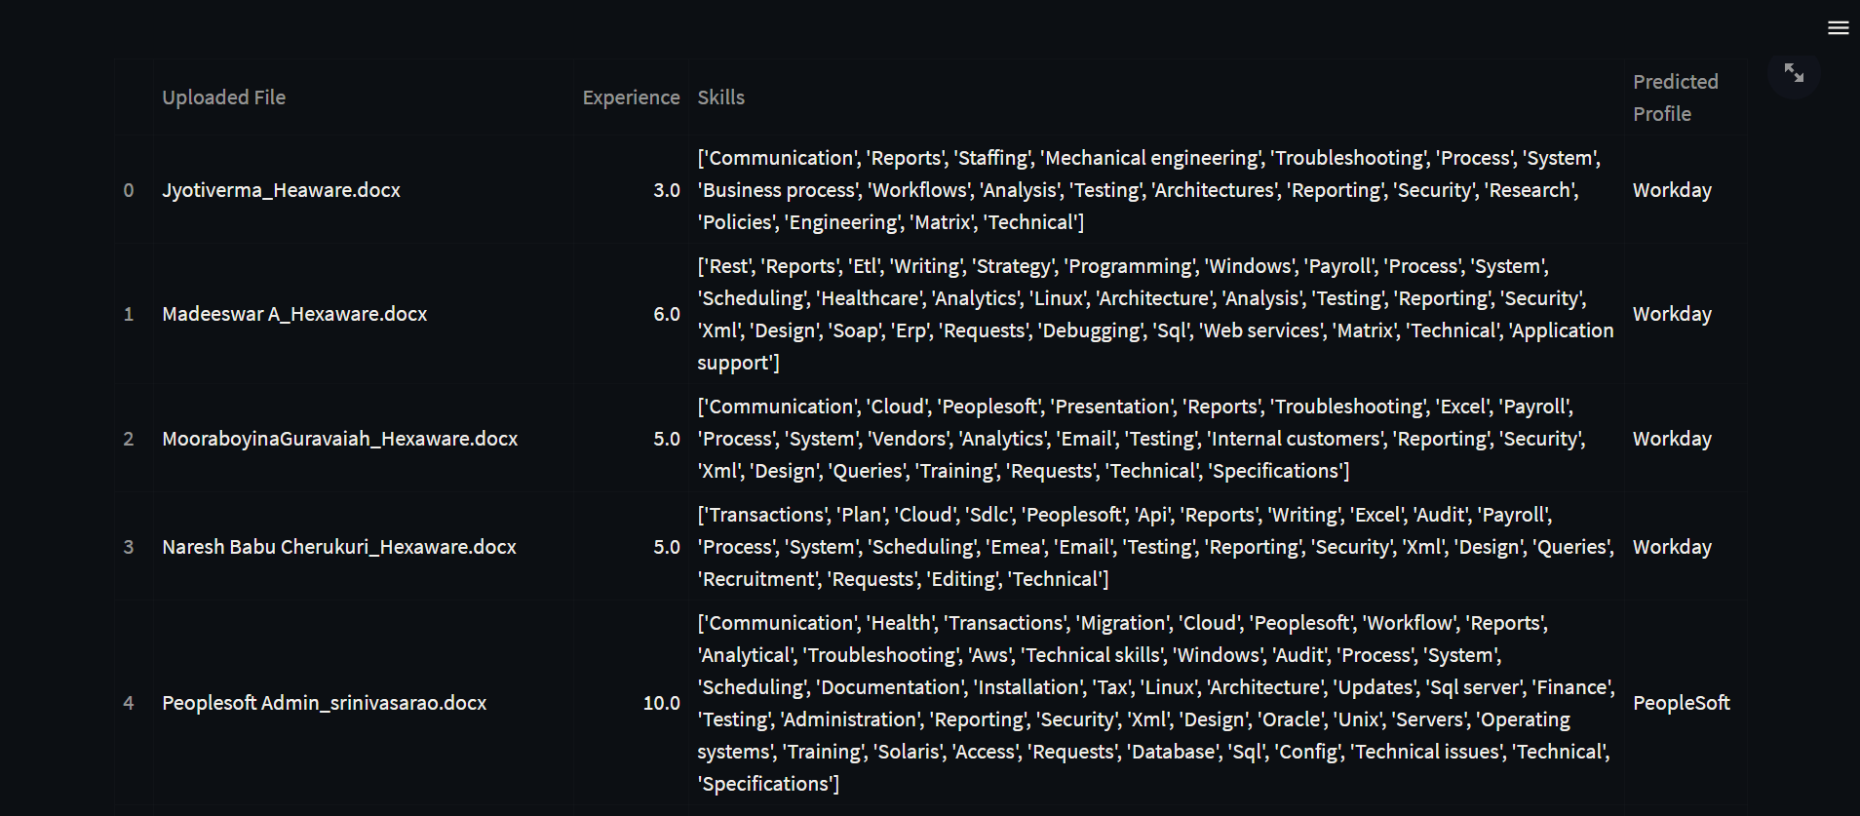
deployment:

Slide 29


